Slide 1
Improving web app with Rust and WebAssembly
ILYA BARYSHNIKOV
2019.04.20

Slide 2
About me
I work in Align Technology
previously, JavaScript developer
I use Rust and WebAssembly at work

Slide 3
We use rust and webassembly

Slide 4
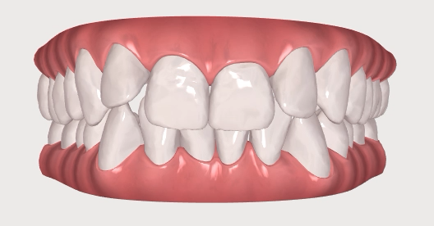

Slide 5
Don’t not break

Slide 6

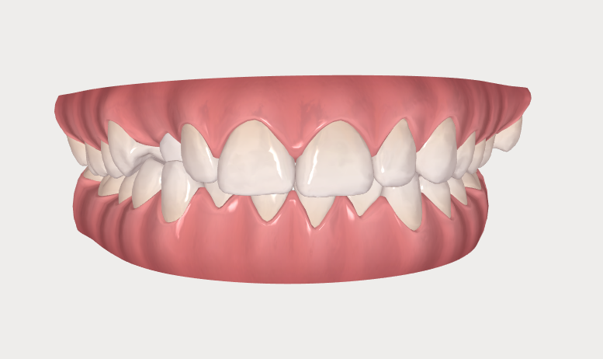
Lights

Slide 7
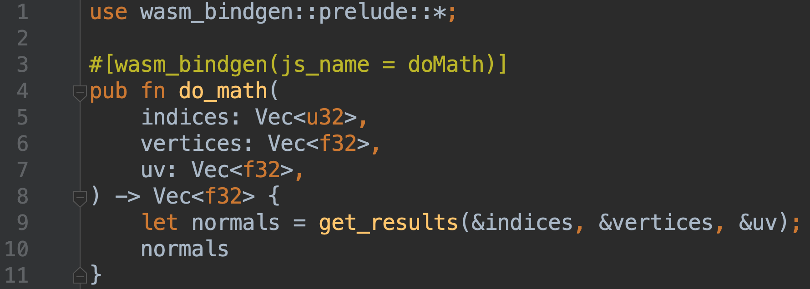

Slide 8
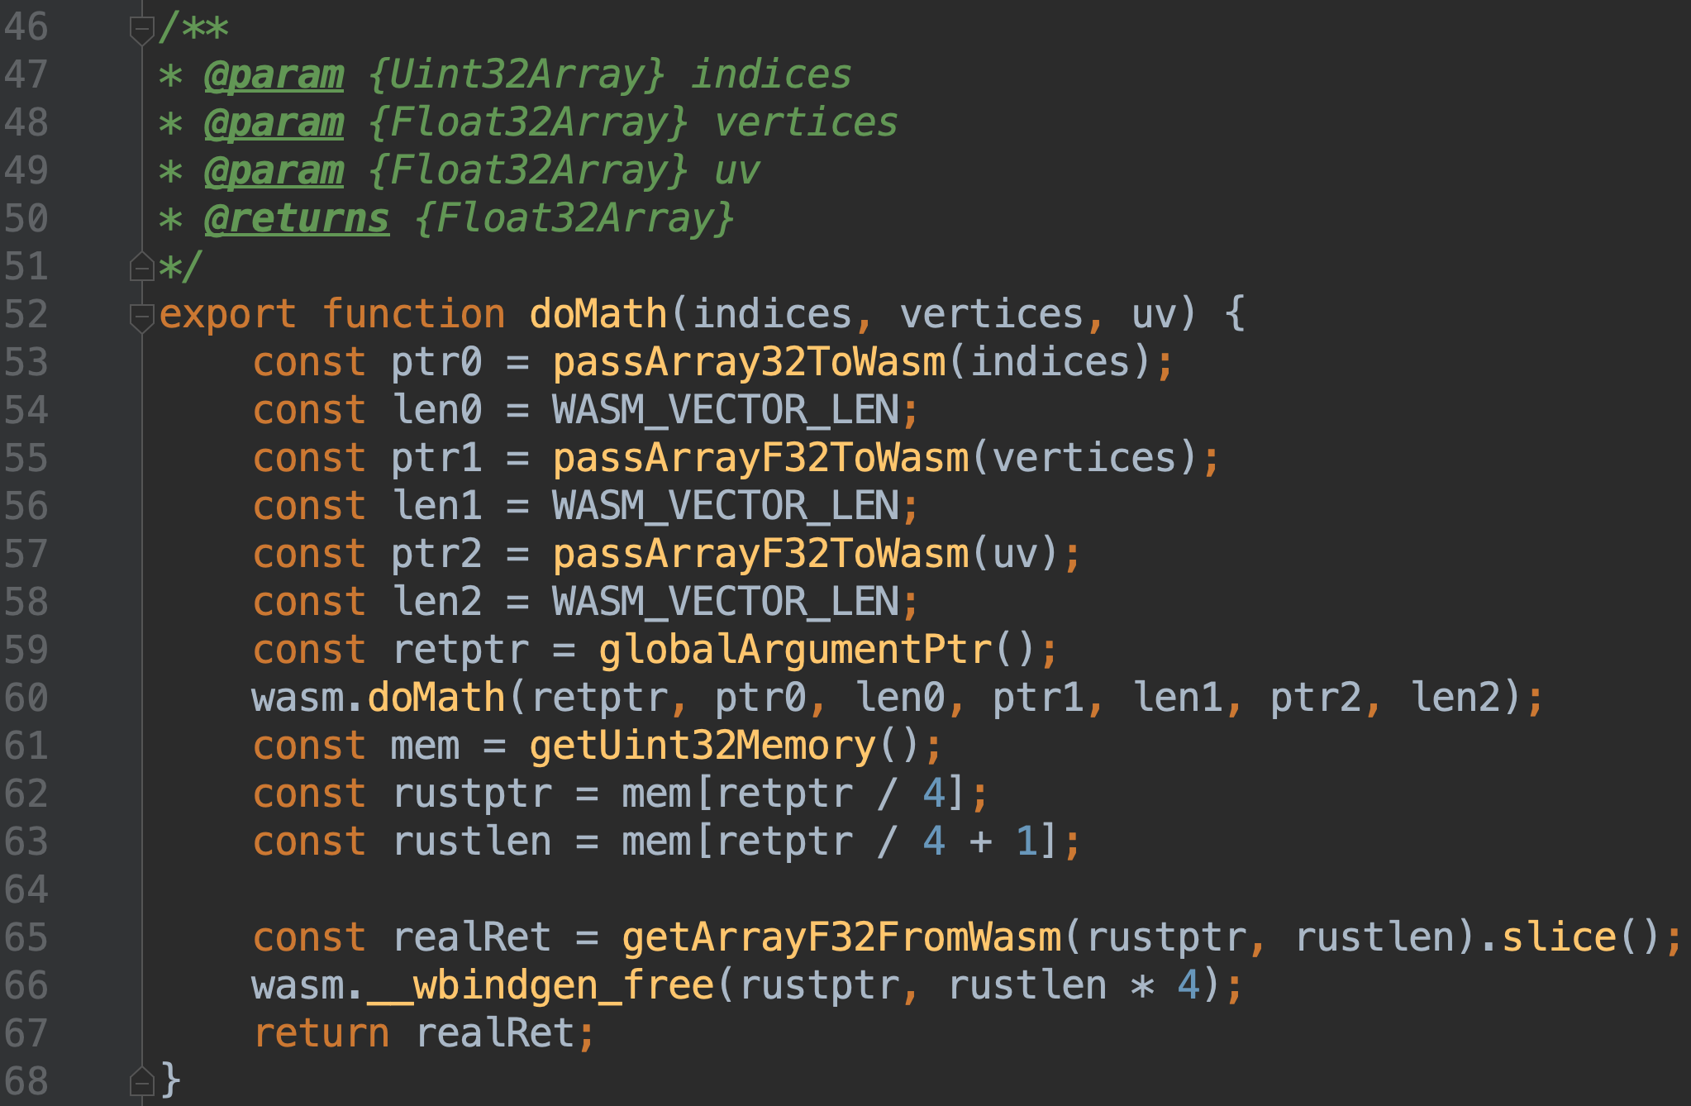

Slide 9
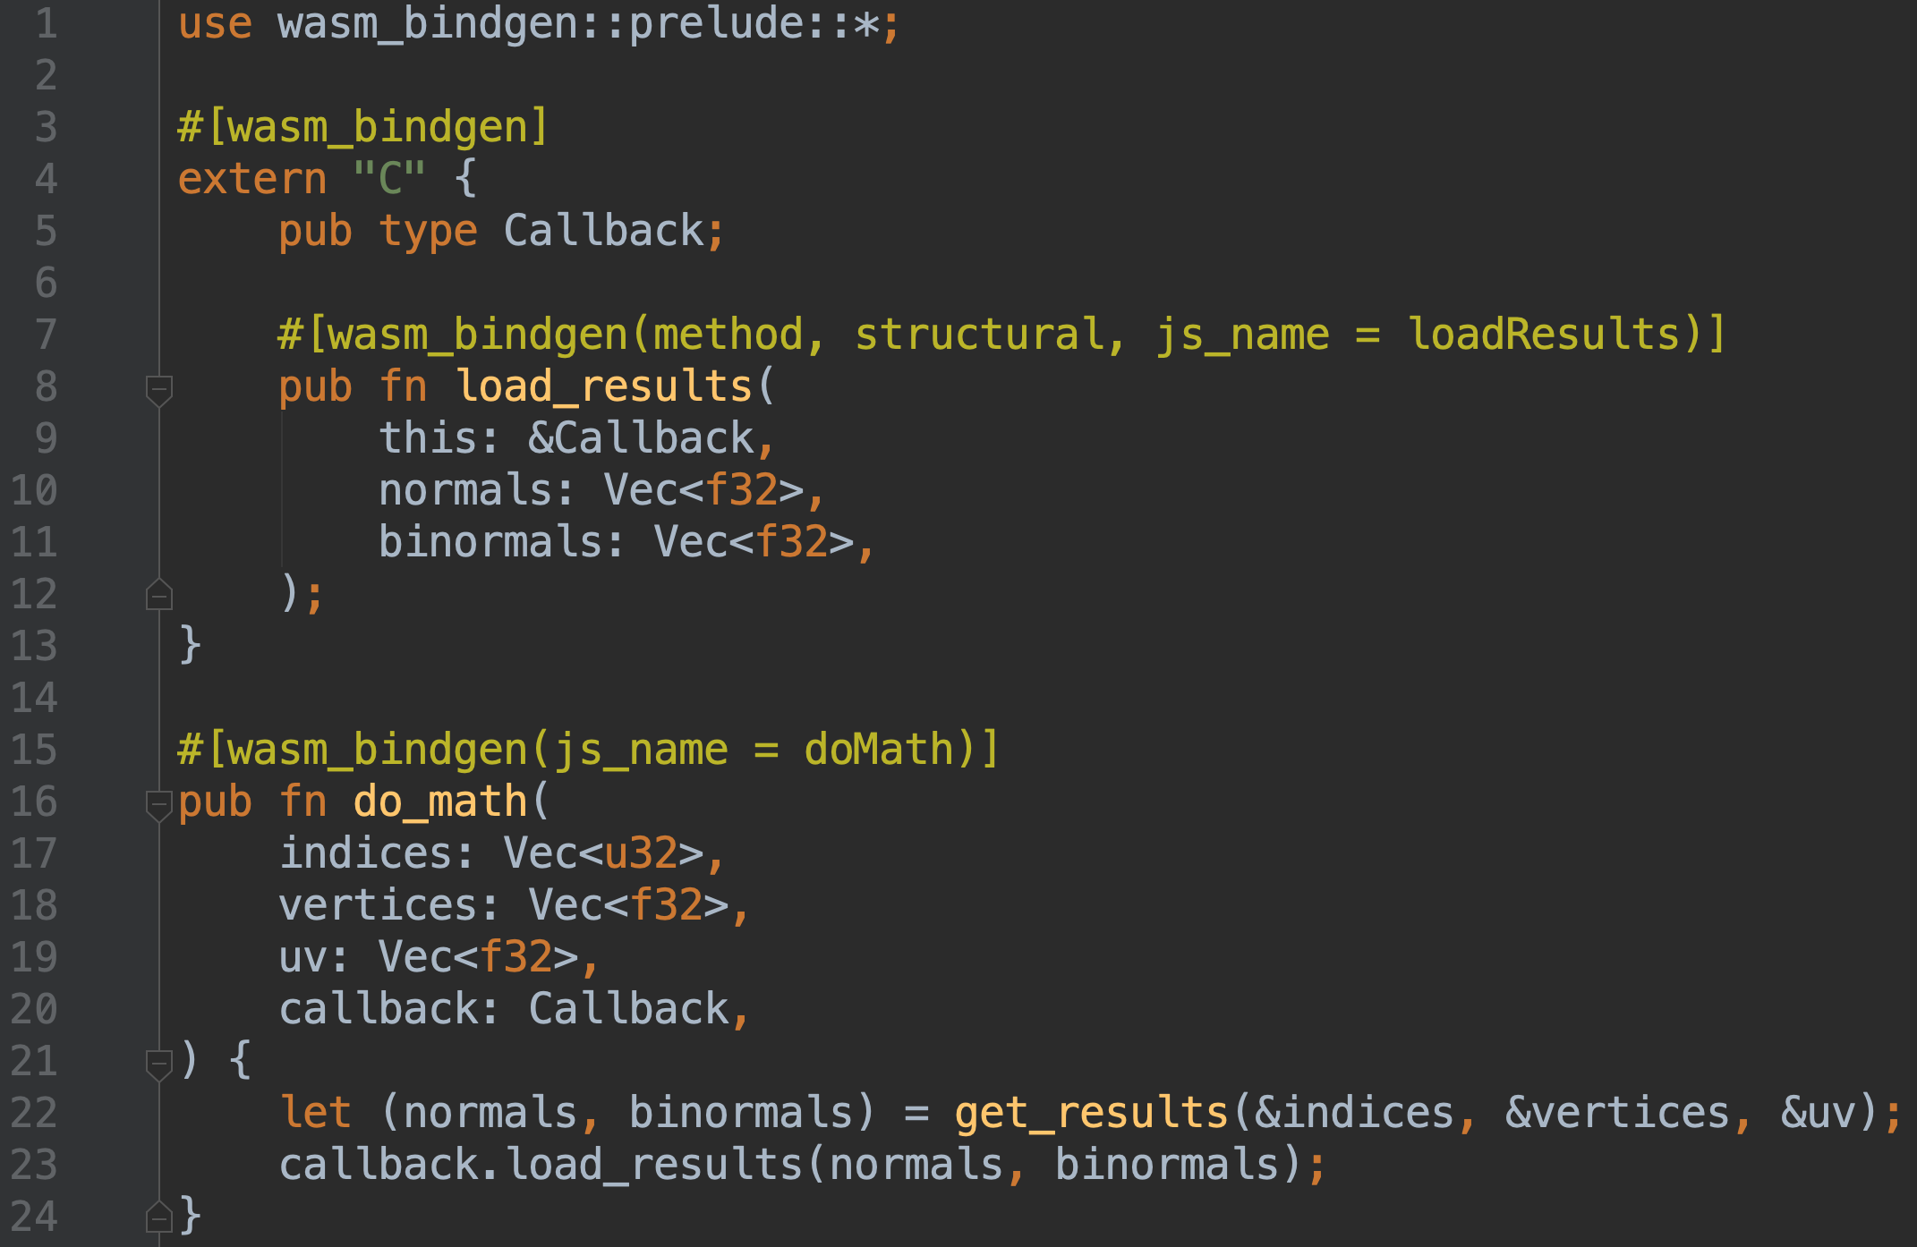

Slide 10
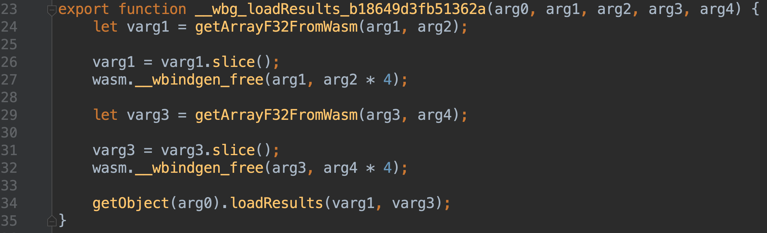

Slide 11
Data description
In: 3 arrays, 60 000 total length
Out: 2 arrays, 30 000 total length

Slide 12
What I measured
JS: computation
WASM: computation + data transfer overhead

Slide 13
What I measured
JS: computation
WASM: computation + data transfer overhead
Looks unfair…

Slide 14
What I measured
JS: computation
WASM: computation + data transfer overhead
Looks unfair… but still faster!

Slide 15
Performance gains
x2 x1.3
development build production build

Slide 16
Performance gains
Most desktop browsers are around x1.3
Safari on ipad is x0.8
Edge is x6

Slide 17
How to improve
Keep state on the wasm side
Create JS typed arrays directly from WebAssembly memory

Slide 18
But it’s a small case, it takes only 2ms

Slide 19
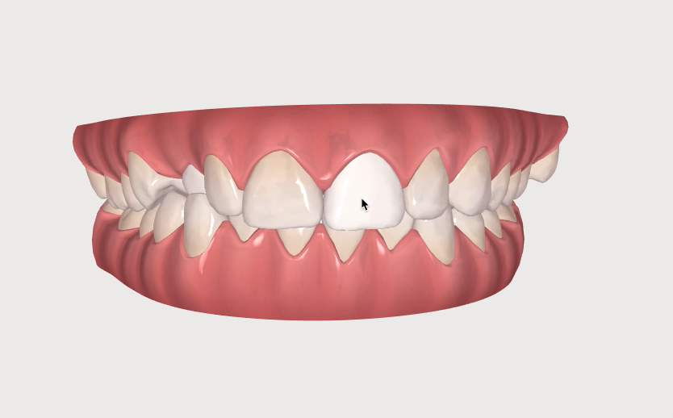
Selecting objects

Slide 20
Time limit per frame is 16ms
Selection takes 4ms
It’s 25% of time!

Slide 21
Real impact
Better FPS in some cases
Less GC
Deliver more features!

Slide 22
Downsides
Higher complexity
Browser support

Slide 23
wasm2js

Slide 24
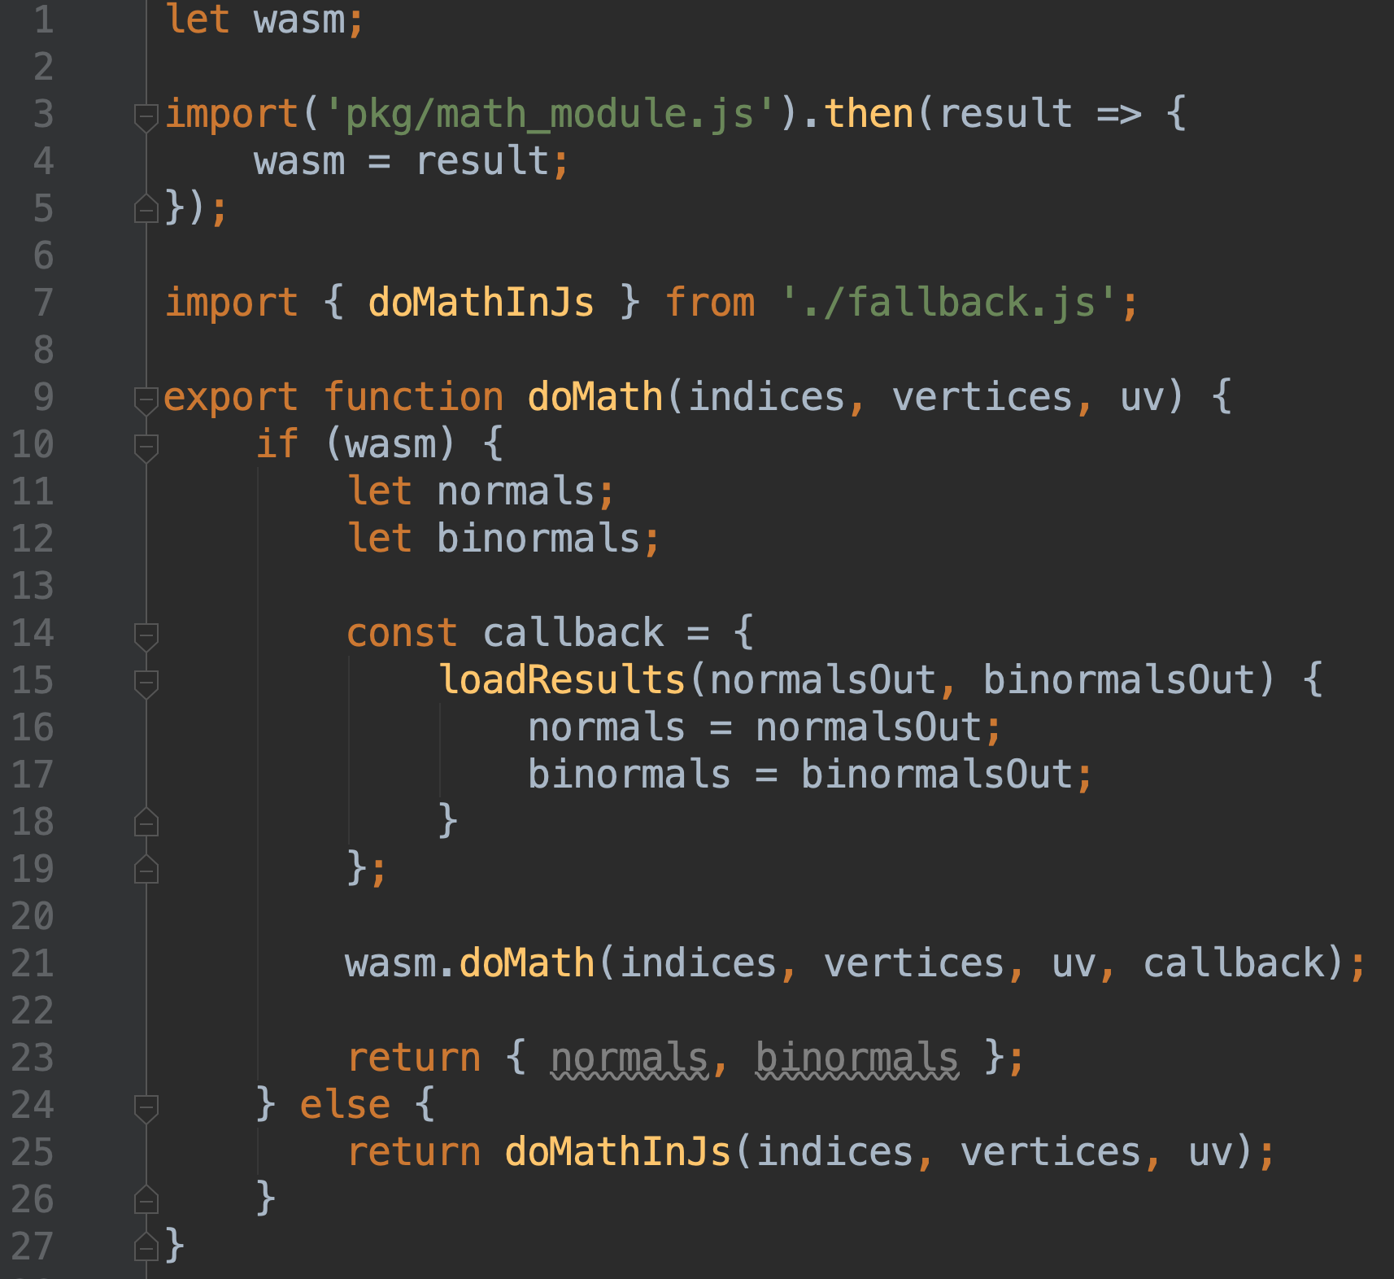

Slide 25
wasm-pack

Slide 26
Quality control
wasm-pack test

Slide 27
Quality control
wasm-pack test
cargo test

Slide 28
Quality control
wasm-pack test
cargo test
cargo2junit

Slide 29
Quality control
wasm-pack test
cargo test
cargo2junit
cargo-audit

Slide 30
Quality control
wasm-pack test
cargo test
cargo2junit
cargo-audit
headless_chrome

Slide 31
future
better wasm2js
gloo – modular web toolkit
wasm-bindgen and stdweb compatibility, initial support released a few days ago!
Web IDL Bindings proposal
WASI (WebAssembly System Interface)

Slide 32

Thanks!
Links:

